Slide 1
Kubernetes Tenant Setup & CLI
Abhilash S
㈜크로센트
2018. 07

Slide 2
Agenda
Kubo Tenant Architecture
UAA Setup
UAA Auth for Kubo
Kubo Roles
Kubo Quotas

Slide 3
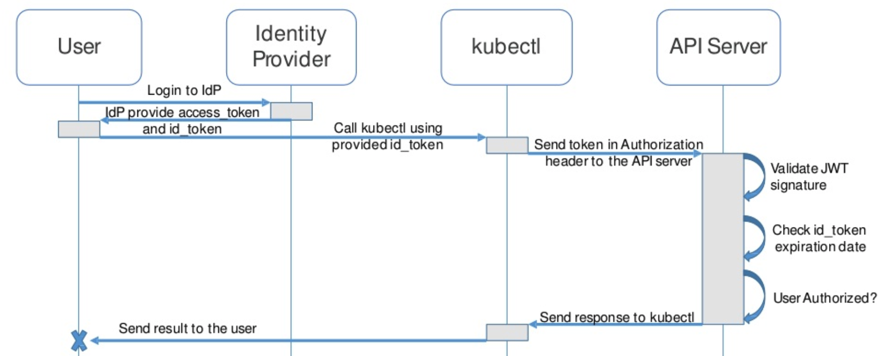
1. Kubo Tenant Architecture (1/2)

Slide 4

1. Kubo Tenant Architecture (2/2)
Model 1
1
UAA User Management
Server
Total Resources
2
Central K8’s Clusters
Administrator
3
K8’s Cluster Resource Quota
Allocation
Service Account
Quota
2
User 1 ~ N
Role
Namespace Tenant

Slide 5
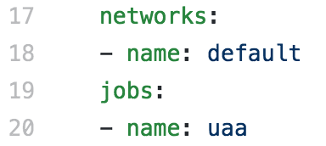
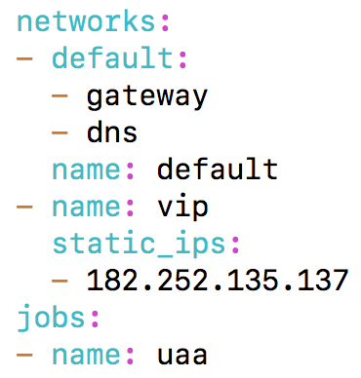
2. UAA Setup (1/5) - UAA-Release (1/5)
Note: This deployment Guide is targeted only Ubuntu 16.04 users.
Note: Perform below steps in your Inception.
ssh into inception
Next clone the bosh-deployment and kubo-deployment repositories
$ ssh -i your-key ubuntu@yours-instance-public-ip
$ cd ~/workspace
$ git clone https://github.com/cloudfoundry/uaa-release.git -b v0.60.2
$ cd ~/ workspace/uaa-release/templates/
Edit uaa-deployment.yml file to configure public ip.
$ vi ~/workspace/uaa-release/templates/uaa-deployment.yml
Before Editing
After Editing

Slide 6
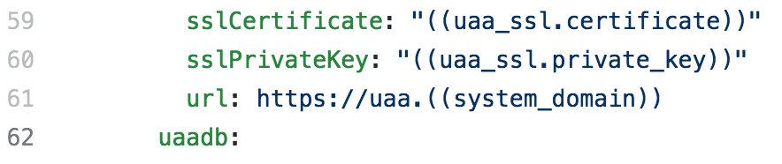
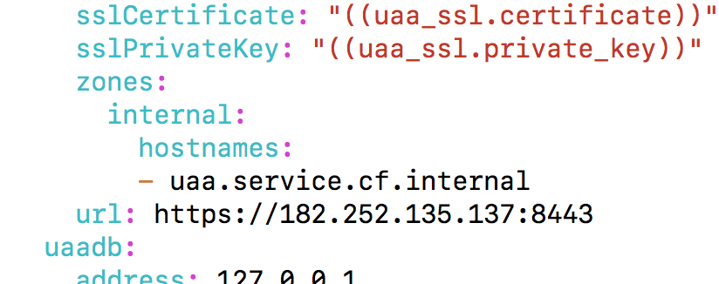
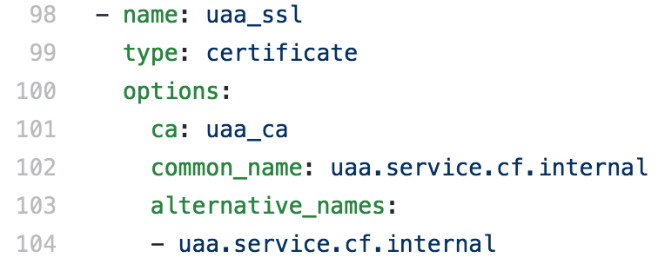
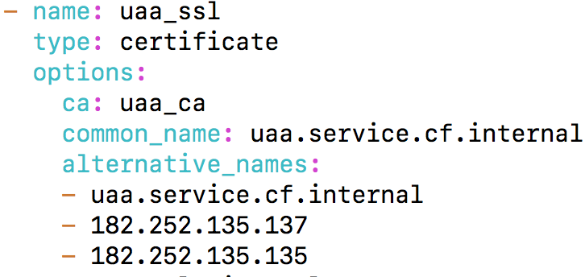
2. UAA Setup (2/5) - UAA-Release (2/5)
Edit uaa-deployment.yml file to configure uaa public ip to uaa-url to access public.
$ vi ~/workspace/uaa-release/templates/uaa-deployment.yml
Before Editing
After Editing
Edit uaa-deployment.yml file to configure public ip and Kubo LB IP server in certificates.
$ vi ~/workspace/uaa-release/templates/uaa-deployment.yml
Before Editing
After Editing

Slide 7
2. UAA Setup (3/5) - UAA-Deployment & Uaa Users (3/5)
Note: Use Kubo Cloud Config for UAA deployment. Make sure to match vm_type, networks & persistent_disk_type.
Deploy Uaa standalone.
$ bosh -e kubo –d uaa deploy ~/workspace/uaa-release/templates/uaa-deployment.yml
Note: Download UAA Certs, Password from credhub as illustrated in Kubo deployment guide.
Note: If you have CF UAA you can target and create user and client .
Target Standalone UAA Server Using uaac cli.
$ uaac target https://your-uaa-public-ip:8443 --skip-ssl-validation
$ uaac token client get admin -s your-uaa_admin_client_secret
Target CF UAA Server Using uaac cli.
$ uaac target https://uaa.your-domain --skip-ssl-validation
$ uaac token client get admin -s your-uaa_admin_client_secret
Add User in targeted UAA Server.
$ uaac user add your-user-name --given_name kubo --family_name kubernetes --email Your-Email --origin uaa -p your-user-password
List all users from UAA Server Using uaac cli.
$ uaac users
Check your user is registered in UAA Server Using uaac cli.
$ uaac user get your-user-name

Slide 8
2. UAA Setup (4/5) - UAA-Clients (4/5)
Create uaa client to configure kubo.
$ cd ~/workspace/uaa-release/templates/ && mkdir kubo && cd ~/workspace/uaa-release/templates/kubo
$ vi kubo-uaa.sh
#!/bin/bash
# Clinet Info
ADMIN=admin
ADMIN_SECRET=your-uaa_admin_client_secret
CLIENT=your-client-name
CLIENT_SECRET=your-client-secret
AUTHORITIES="oauth.login,scim.write,clients.read,scim.userids,password.write,clients.secret,clients.write,uaa.admin,scim.read,doppler.firehose"
AUTHORIZED_GRANT_TYPES="client_credentials,password,refresh_token" # authorization_code,implicit
SCOPE="cloud_controller.read,cloud_controller.write,openid,cloud_controller.admin,scim.read,scim.write,doppler.firehose,uaa.user,routing.router_groups.read,uaa.admin,password.write"
# [2] Add Client
uaac target https://your-uaa-public-ip:8443 --skip-ssl-validation
uaac token client get $ADMIN -s $ADMIN_SECRET
uaac client add $CLIENT --name $CLIENT -s $CLIENT_SECRET \
--authorities $AUTHORITIES \
--authorized_grant_types $AUTHORIZED_GRANT_TYPES \
--scope $SCOPE
Grant permissions for kubo-uaa.sh file and create client in uaa setver for kubo dpeloyment.
$ chmod 777 ~/workspace/uaa-release/templates/kubo/kubo-uaa.sh
$ ./kubo-uaa.sh
List all clients from UAA Server Using uaac cli.
$ uaac clients
Check your user is registered in UAA Server Using uaac cli.
$ uaac client get your-client-name

Slide 9
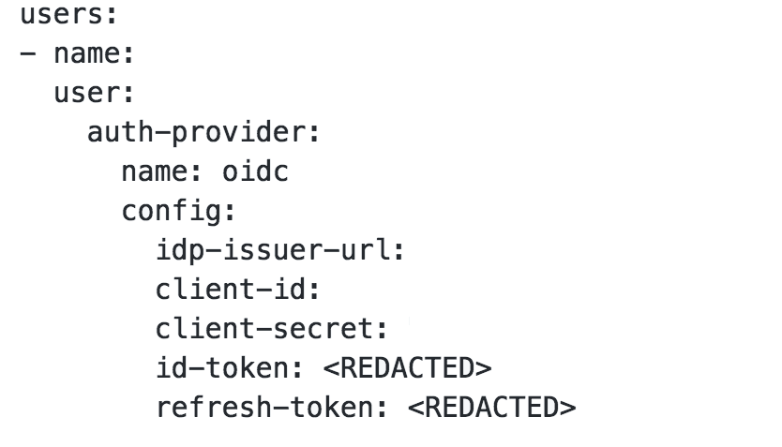
2. UAA Setup (5/5) - UAA-Config (5/5)
Install uaak cli to create uaa config.
$ cd ~/workspace/
$ git clone https://github.com/abhilash07/uaa.git && cd ~/workspace/uaa
$ chmod +x uaak
$ sudo mv ~/workspace/uaa/uaak /usr/local/bin/uaak
$ uaak -h
Create uaa config to configure kubo config using uaak cli.
$ uaak -uaa.username=Your-Email -uaa.password=your-user-password -uaa.client_id=your-client-name -uaa.client_secret=your-client-secret -uaa.url=https://your-uaa-public-ip:8443 -uaa.skip_ssl_verify=true >> ~/workspace/uaa-release/templates/kubo/uaa-kubo.json
Sample Output
Your-Email
https://your-uaa-public-ip:8443/oauth/token
your-client-name
your-client-secret

Slide 10
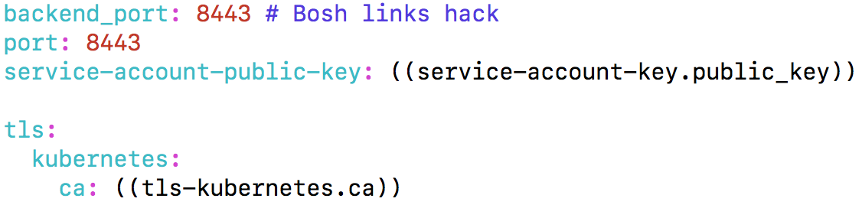
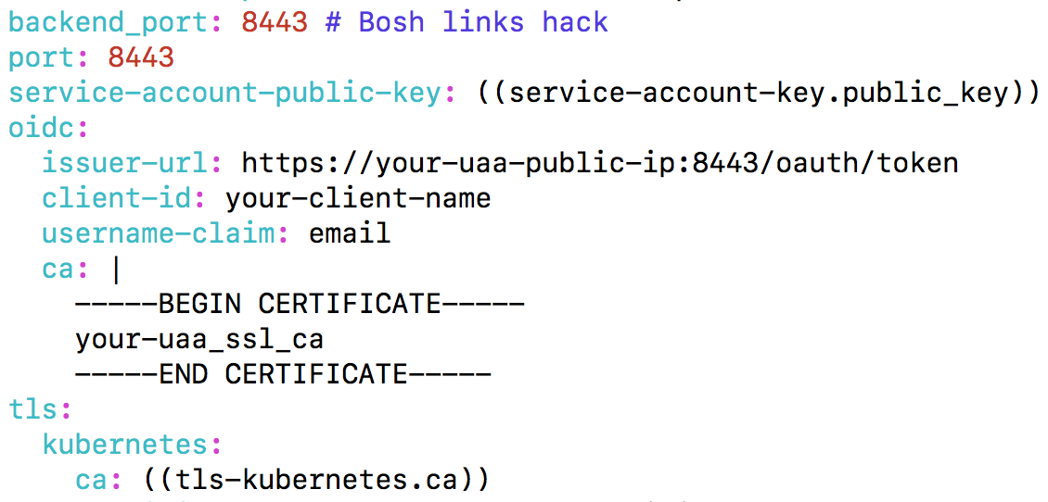
3. UAA Auth kubo (1/4) - Kubo OAuth (1/4)
Note: Make Sure to have Kubo deployment environment. If not please follow deployment guide to deploy on your preferred IaaS.
Edit kubo-deployment cfcr.yml file for configuring uaa.
$ vi ~/workspace/kubo-deployment/manifests/cfcr.yml
Before Editing
After Editing
Update your cfcr deployment on your preferred IaaS, to configures uaa with kubernetes api-server.

Slide 11
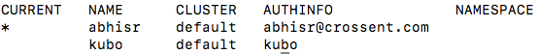
3. UAA Auth kubo (2/4) - Kubo config (2/4)
Note: You should target existing Kubo cluster (Master API Server) before configuring below uaa user .
Update Kubo config in ~/.kube/config using kubectl cli. Get tokens and other values from uaa-kubo.json.
Note: Get uaa-kubo.json file form section 2 UAA Setup (5/5) - UAA-Config (5/5) .
kubectl config set-credentials Your-Email --auth-provider=oidc --auth-provider-arg=idp-issuer-url=https://your-uaa-public-ip:8443/oauth/token --auth-provider-arg=client-id=your-client-name --auth-provider-arg=client-secret=your-client-secret --auth-provider-arg=refresh-token=your-refresh-token --auth-provider-arg=idp-certificate-authority=your-uaa_ssl.crt --auth-provider-arg=id-token=your-id-token
Configure k8s cluster context with you above uaa user.
$ kubectl config set-context <context-name> --cluster <cluster-name> --user <Your-Email>
$ kubectl config use-context <context-name>
List your k8s cluster contexts.
$ kubectl config get-contexts
Sample Output
← Your Uaa User
← Your kubo admin User
Note: * in above screenshot represents the current context of your k8s cluster

Slide 12
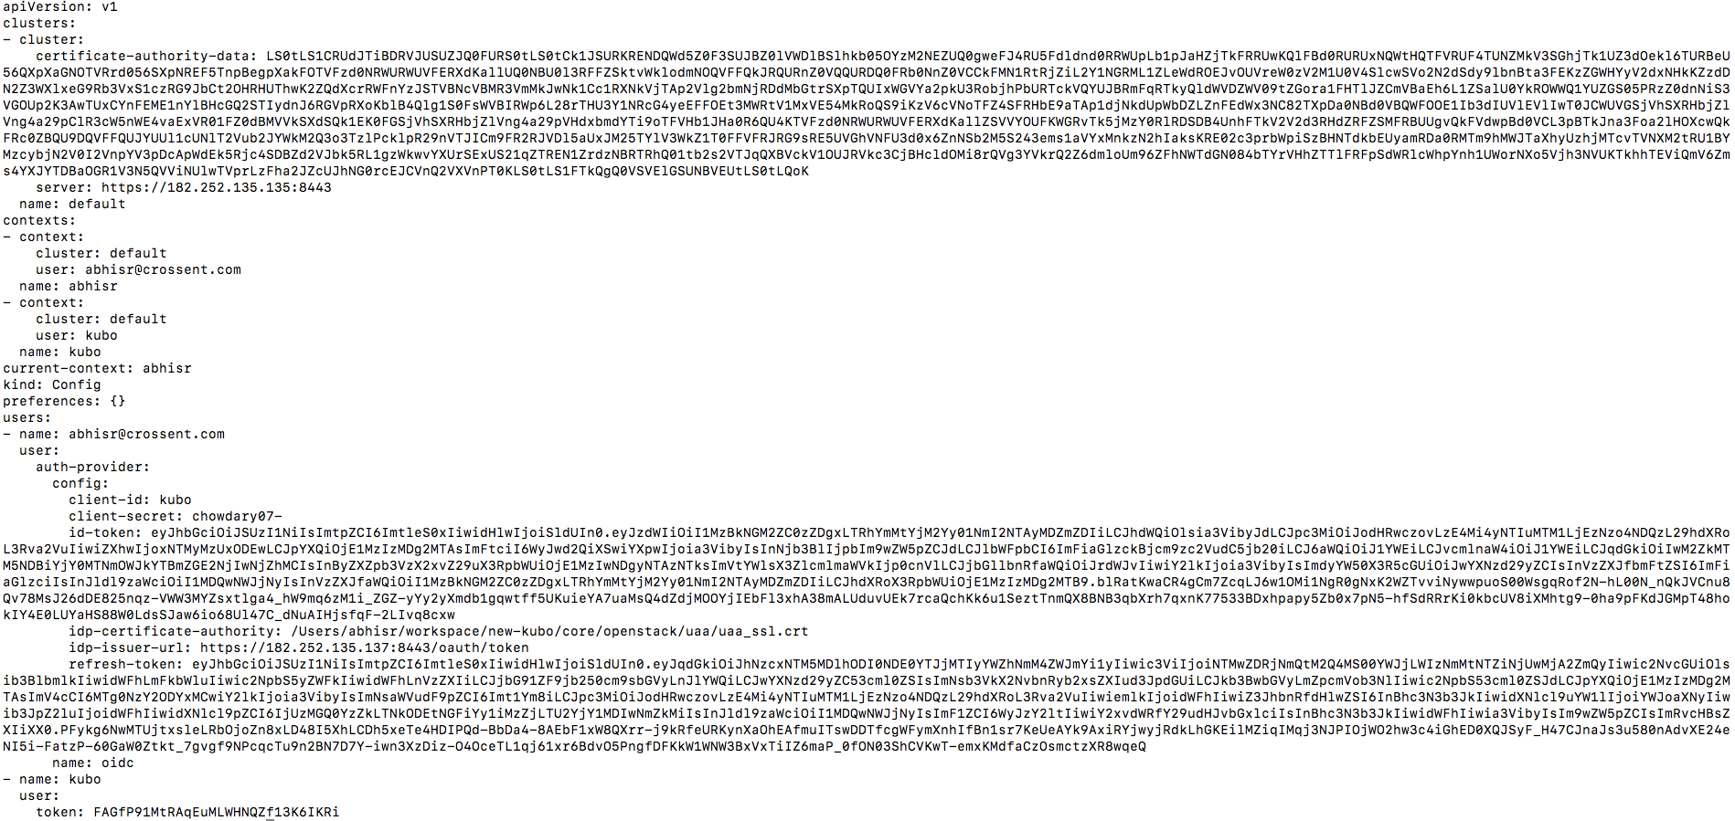
3. UAA Auth kubo (3/4) - Kubo config (3/4)
Sample Output of kubo config after configuring your uaa user and client
your uaa user context in kubo config
your uaa user configuration in kubo config

Slide 13
3. UAA Auth kubo (4/4) - Kubo config (4/4)
Note: To utilize resources from k8s cluster request your administrator to create ClusterRole or Role to register your Uaa User to K8s api-server .
Change the k8s admin context to create ClusterRole and Role.
$ kubectl config use-context kubo
Note: After changing to k8s admin context, next section explain how to create ClusterRole and Role to register your Uaa User to K8s api-server.
List your k8s cluster contexts.
$ kubectl config get-contexts
Sample Output
← Your Uaa User
← Your kubo admin User
Note: * in above screenshot represents the current context of your k8s cluster

Slide 14
4. Kubo Roles (1/2) - Role Architecture
Role, controls the entire resources allocated to uaa user and also controls all the objects with in the namespace only.
1
Kubernetes Cluster
Administrator
2
Total
Resources
UAA or
Service Account
2
Resource
Allocation
Role
2
Namespace
3
Workloads
Discovery &
Load Balancing
Config &
Storage
Pods
Deployments
Replica Sets
Replication Controllers
etc …
Ingresses
Services
Config Maps
Persistent Volume Claims
Secrets

Slide 15
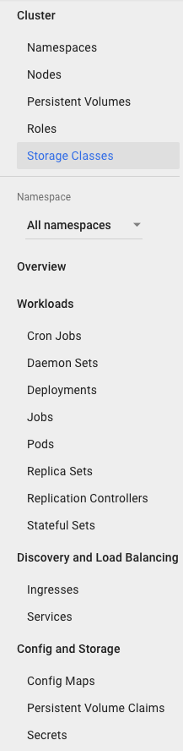
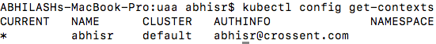
4. Kubo Roles (2/2) - Role Deployment
Note: In this tutorial we enable all permissions for Role user. For limited permissions follow this link. Role
1
1. Create Namespace
2
$ kubectl create –f namespace.json
namespace.json
{
"kind": "Namespace",
"apiVersion": "v1",
"metadata": {
"name": "abhi"
}
}
Role: In the RBAC API, a role contains rules that represent a set of permissions. Permissions are purely additive (there are no “deny” rules). A role can be defined within a namespace with a Role.
2. Create Role
role.yml
$ kubectl create –f role.yml
kind: Role
apiVersion: rbac.authorization.k8s.io/v1
metadata:
namespace: abhi
name: role-namespace
rules:
- apiGroups: ["*"]
resources: ["*"]
verbs: ["*"]
---
kind: RoleBinding
apiVersion: rbac.authorization.k8s.io/v1
metadata:
name: role-namespace-binding
namespace: abhi
subjects:
- kind: User
name: abhisr@crossent.com
apiGroup: rbac.authorization.k8s.io
roleRef:
kind: Role
name: role-namespace
apiGroup: rbac.authorization.k8s.io
Sample Output
2. Now we can start deploying service and pods at Namespace
by using above Role.
3. Change to tenant context to start using namespace resources
and services.
$ kubectl config use-context abhisr
Sample Output
← Your Uaa User

Slide 16
5. Kubo Quotas (1/4) - Resource Quota
When Kubernetes cluster is used by multiple people or teams, resource management becomes more important.
You Want to be able to manage the resources you give to a person or a team. Because you don’t want one person or team taking up all the resources.
In this tutorial Resource Quota divided into two parts, 1) Resource Limits & 2) Object Limits.
1) Resource Limits: Administrator can set CPU, Memory and storage limitation for namespace tenant.
2) Object Limits: Administrator can set Pods, configmaps, services, persistentvolumeclaims, replicationcontrollers, secrets etc. limitation for namespace tenant.
1
Kubernetes Cluster
Administrator
2
Total
Resources
UAA or
Service Account
3
User Role (1 ~ N )
3
Namespace
Resource
Allocation
4
Resource Limits
Objects Limits
CPU
Memory
Storage
pods
configmaps
services
persistentvolumeclaims
secrets
etc …

Slide 17
5. Kubo Quotas (2/4) - Resource Quota
Note: Please Create Namespace and Role before creating Resource Quota by following 4. Kubo Roles Section.
1. Create Resource Limits
$ kubectl create –f resource-limit.yml
resource-limit.yml
apiVersion: v1
kind: ResourceQuota
metadata:
name: compute-quota
namespace: tenant
spec:
hard:
pods: “4”
requests.cpu: "1"
requests.memory: 1Gi
limits.cpu: "2"
limits.memory: 2Gi
Resource Limits: Administrator can set CPU, Memory and storage limitation for namespace tenant.
2. Create Object Limits
$ kubectl create –f object-limit.yml
object-limit.yml
apiVersion: v1
kind: ResourceQuota
metadata:
name: object-quota
namespace: tenant
spec:
hard:
configmaps: "10"
persistentvolumeclaims: "4"
replicationcontrollers: "20"
secrets: "10"
services: "10"
services.loadbalancers: "2"
Object Limits: Administrator can set Pods, configmaps, services, persistentvolumeclaims, replicationcontrollers, secrets etc. limitation for namespace tenant.

Slide 18
5. Kubo Quotas (3/4) - Resource Quota Deployment
Note: Please Create resource-limit and object-limit by following 5. Kubo Quotas → Resource Quota Section.
1. Create deployment with quotas
$ kubectl create –f deployment-with-quotas.yml
deployment-with-quotas.yml
apiVersion: extensions/v1beta1
kind: Deployment
metadata:
name: helloworld-deployment
namespace: tenant
spec:
replicas: 3
template:
metadata:
labels:
app: helloworld
spec:
containers:
- name: k8s-demo
image: wardviaene/k8s-demo
ports:
- name: nodejs-port
containerPort: 3000
resources:
requests:
cpu: 200m
memory: 0.5Gi
limits:
cpu: 400m
memory: 1Gi
Each container can specify request capacity and capacity limits.
Request capacity is an explicit requests for resources, we can this it as minimum amount of resource the pod needs.
Resource limit is a limit imposed to the container, it means the container will not be able to utilize more resources than specified.
You run a deployment with a pod with a CPU resource request of 200m.
Here 200m = 200 millicpu (also known as 200 millicores). 200m = 0.2 which is 20% of a CPU core of a running worker nodes. For example if you have 2 Cores, it’s still 20% usage from our total cores.
Memory quotas are defined by MiB or GiB.

Slide 19
5. Kubo Quotas (4/4) - Resource Default Quota
Note: Please Create Namespace and Role before creating Resource Default Quota by following 4. Kubo Roles Section.
1. Create Resource Limits
$ kubectl create –f default.yml
default.yml
apiVersion: v1
kind: LimitRange
metadata:
name: limits
namespace: tenant
spec:
limits:
- default:
cpu: 200m
memory: 512Mi
defaultRequest:
cpu: 100m
memory: 256Mi
type: Container
Resource Default Quota: Some times user don’t wants to mention quotas
in container creation.
deployment-with-no-quotas.yml
apiVersion: extensions/v1beta1
kind: Deployment
metadata:
name: helloworld-deployment
namespace: tenant
spec:
replicas: 3
template:
metadata:
labels:
app: helloworld
spec:
containers:
- name: k8s-demo
image: wardviaene/k8s-demo
ports:
- name: nodejs-port
containerPort: 3000
2. Create deployment with out quotas
$ kubectl create –f deployment-with-no-quotas.yml

Slide 20
THANK YOU

